Slide 1
George Rykwalder
Roots in the Old Country

Slide 2
When and where was he born?
1887 Passenger list b. abt 1870 Hungary
1900: b. April 1870 Austria
1910 b. Abt. 1870 Hungary [Polish]
1920 b. Abt. 1871 Austria [Slavanic]
1930 b. Abt. 1870 Czechoslovakia [Slovac]
1940 b. Abt. 1871 Austria
1950 death record b. 14 April 1870 Czechoslovakia

Slide 3
1940 Instructions to Enumerators:
Place of Birth
For a persons born in any of those central European areas where there have been recent changes in boundaries, enter in col. 15 as country of birth that country in which his birthplace was situated on January 1, 1937. Note that the list of countries in Europe on that date included Austria, Czechoslovakia, and Poland. If you cannot find out with certainty the country in which the person's birthplace was located on January 1, 1937, enter the name of the province, state, or city in which the persons was born, such as Bohemia, Slovakia, Croatia, etc., or Prague, Bratislava, Vienna, etc.

Slide 4
1930 Instructions
Since it is essential that each foreign-born person be credited to the country in which his birthplace is now located, special attention must be given to the six countries which lost a part of their territory in the readjustments following the World War. These six countries are as follows:
Austria, which lost territory to Czechoslovakia, Italy, Yugoslavia, Poland, and Rumania.
Hungary, which lost territory to Austria, Czechoslovakia, Italy, Poland, Rumania, and Yugoslavia.
Bulgaria, which lost territory to Greece and Yugoslavia.
Germany, which lost territory to Belgium, Czechoslovakia, Danzig, Denmark, France, Lithuania, and Poland.
Russia, which lost territory to Estonia, Finland, Latvia, Lithuania, Poland, and Turkey.
Turkey, which lost territory to Greece and Italy and from which the following areas became independent:
Iraq (Mesopotamia); Palestine (including Transjordan); Syria (including Lebanon); and various States
and Kingdoms in Arabia (Asir, Hejaz, and Yemen).
168. If the person reports one of these six countries as his place of birth or that of his parents, ask specifically whether the birthplace is located within the present area of the country; and if not, find out to what country it has been transferred. If a person was born in the Province of Bohemia, for example, which was formerly in Austria but is now a part of Czechoslovakia, the proper return for country of birth is Czechoslovakia. If you can not ascertain with certainty the present location of the birthplace, where this group of countries is involved, enter in addition to the name of the country, the name of the Province or State in which the person was born, as Alsace-Lorraine, Bohemia, Croatia, Galicia, Moravia, Slovakia, etc., or the city, as Warsaw, Prague, Strasbourg, etc.

Slide 5
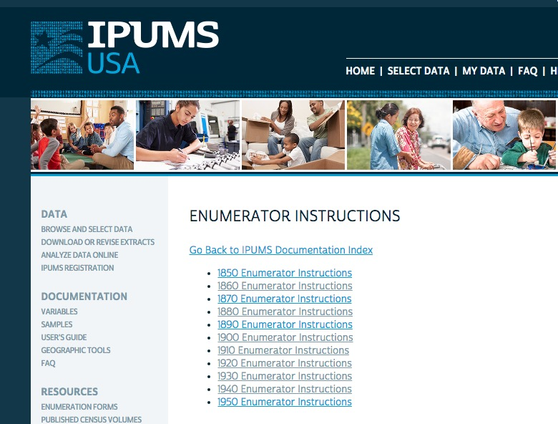
Where to find
Instructions to the Enumerators
https://usa.ipums.org/
usa/voliii/
tEnumInstr.shtml
Or Google Instructions
To Enumerators

Slide 6
Checking the Instructions
Instructions to the Enumerators help you
better understand the information provided.
It is especially important to check Instructions when working with race designations.
Handy to understand relation to head of household.
If something puzzles you, immediately check the Instructions to the Enumerators.

Slide 7
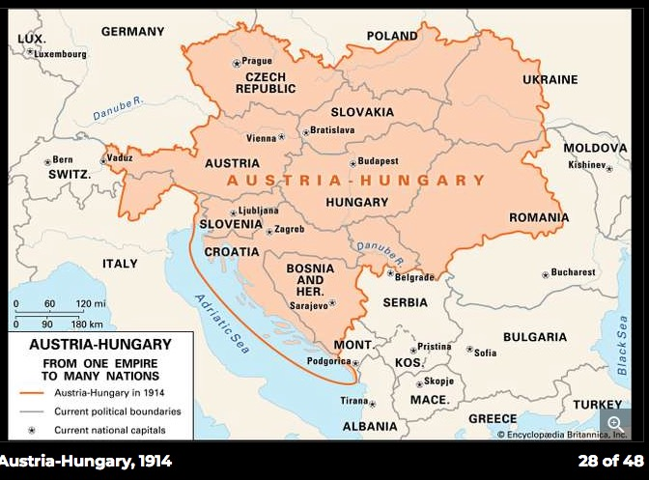
Austria-Hungary 1867-1918

Slide 8
Rule for European Research
Find the town village of origin!
Yes!
The town or village!

Slide 9
So our question is…
What is the town village of birth in the Austria-Hungarian Empire of George Reichwalder/ Rykwalder, who was born about April 14, 1870 and immigrated between 1887-1889.

Slide 10
What records might show that?
Family records
Clues in census records
Origins of other family members or close associates
Naturalization Records
Passenger lists

Slide 11
Immigration information in census records
1900: arriv. 1887 13 yrs in U.S. NA
1910: arriv: 1887 NA
1920: arriv: 1889 NA yr of nat: 1891
1930: arriv 1890 NA
1940: NA
NA = Naturalized
AL=Alien
PA= Papers Filed

Slide 12
Research Plan
2 separate, but related, research efforts:
  1. Find his naturalization papers
  2. Find passenger list information

Slide 13
How to Find Naturalization Records
Pre 1907 Naturalization Records are found at the state level
Arrived New York 1887
Naturalized about 1891 – where?
Son born Ottawa Co., Ohio in 1898
He lived in Ohio in 1900

Slide 14
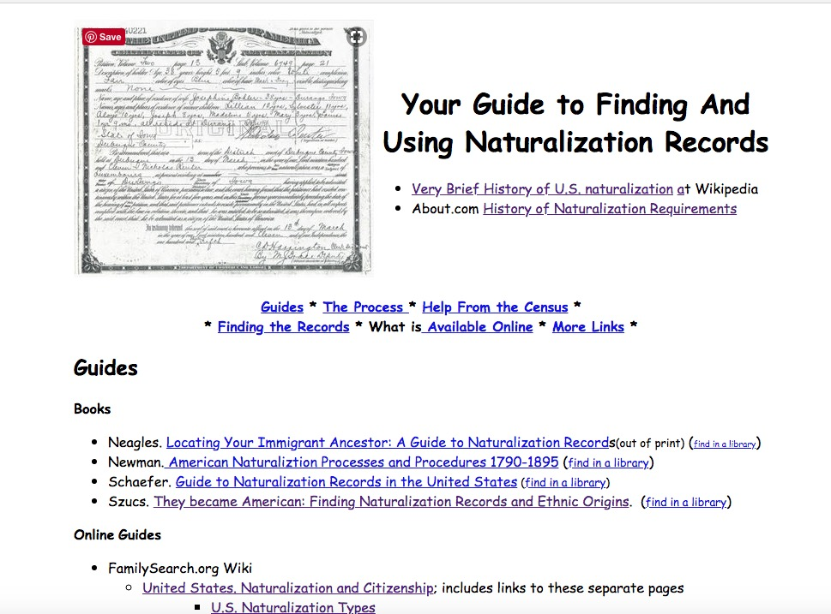
Your Guide to…Naturalization Records http://barbsnow.net/naturalization.html

Slide 15
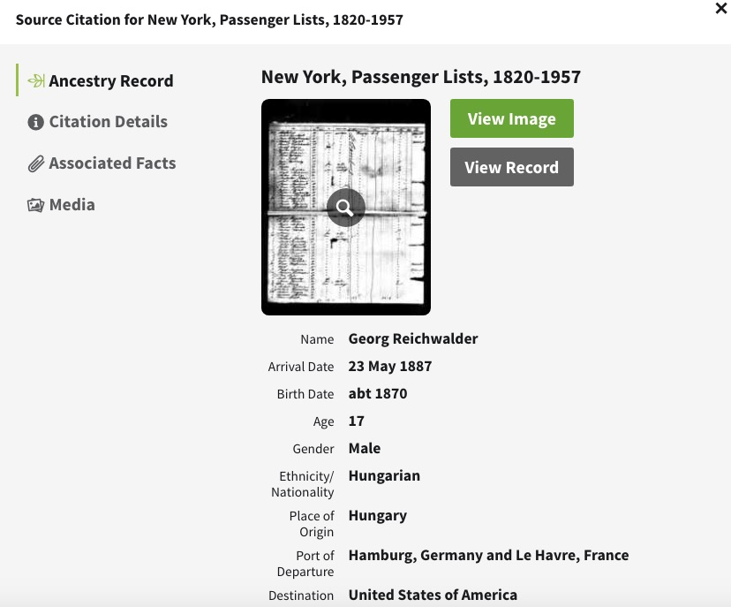
Passenger Lists:
We already have a likely record
Port of Departure:
Hamburg

Slide 16
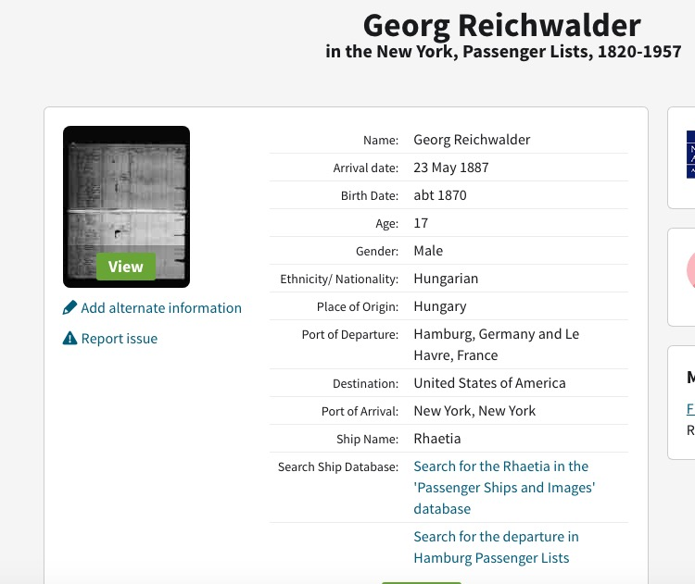
This is what we see when we “view record” from a record attached to someone in a tree
The summary differs a little. This one offers a different link.
A handy link to
the Hamburg
Passenger Lists

Slide 17
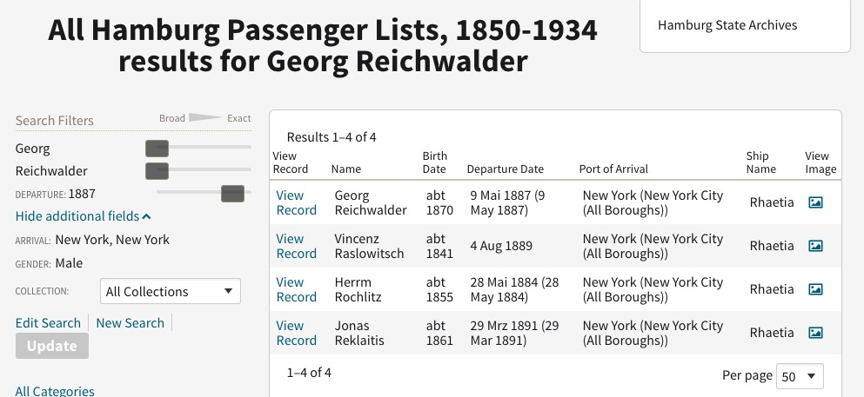
Hamburg Passenger List Results
Search from the Passenger List entry

Slide 18
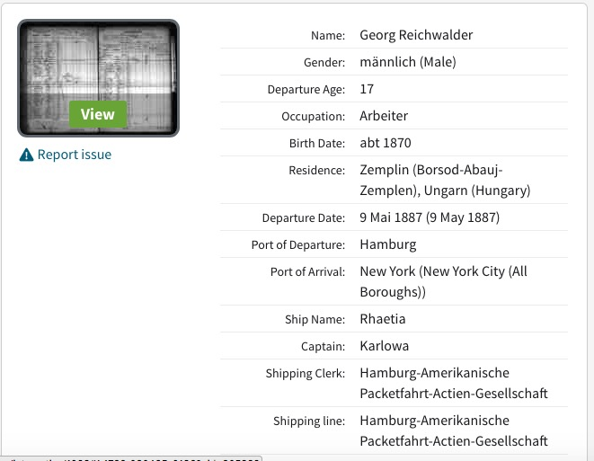
Is this our George Rykwalder?

Slide 19
What’s next?
Look for the [1891?] naturalization record?
OR
Start searching in Borsod-Abaúj-Zemplén County, Hungary?

Slide 20
Exhaust U.S. resources first
http://barbsnow.net/naturalization.html

Slide 21
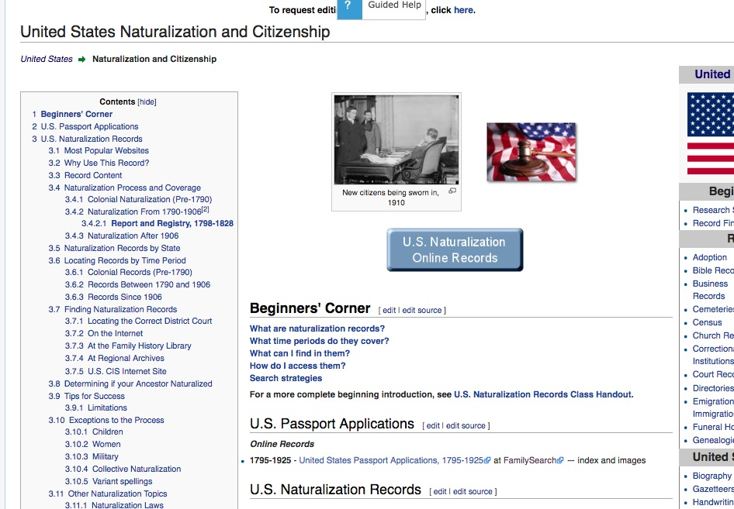
Family Search Wiki
– always a first step.

Slide 22
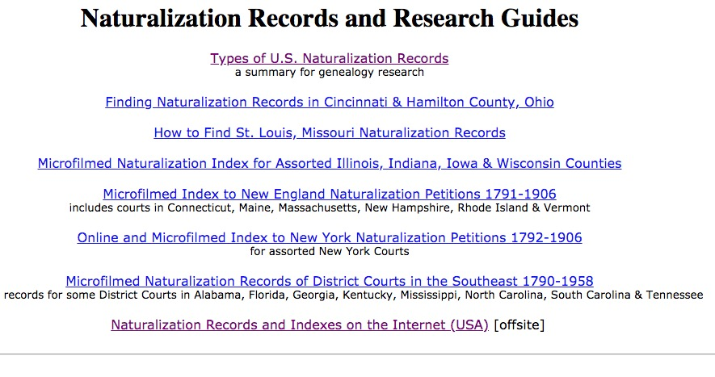
Joe Beine’s guides to information on the internet.
http://www.genealogybranches.com/naturalizationrecs.html

Slide 23

Books that will help your research are available at the LDS/GSWC Library

Slide 24
And books on how to find and use naturalization records.

Slide 25
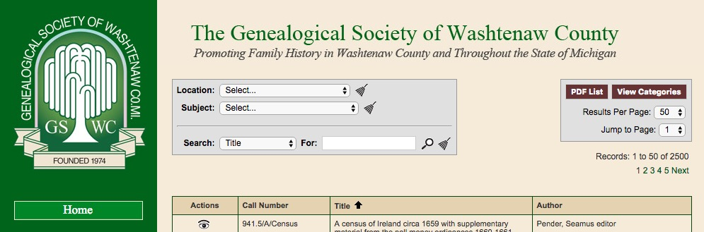
Search for books

Slide 26
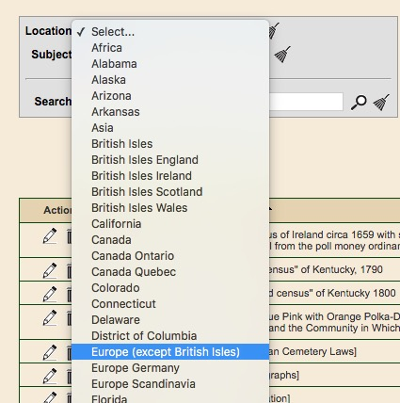
A drop down provides a list of choices

Slide 27
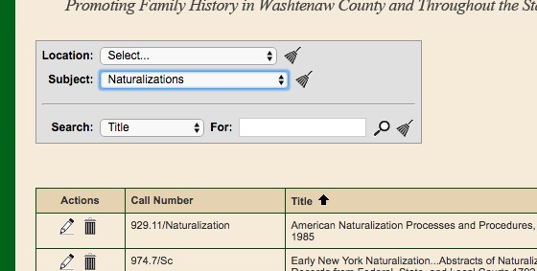
Location & Subject searches
Results appear below

Slide 28
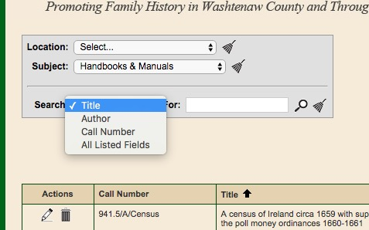
Combine information

Slide 29
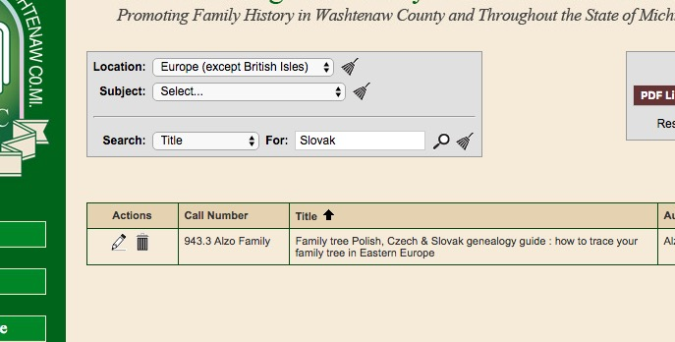
We have the how-to book on Polish, Czech and Slovak research

Slide 30
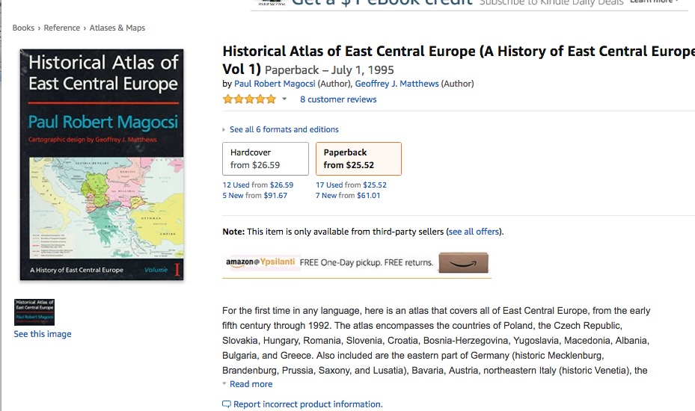
We own this...

Slide 31
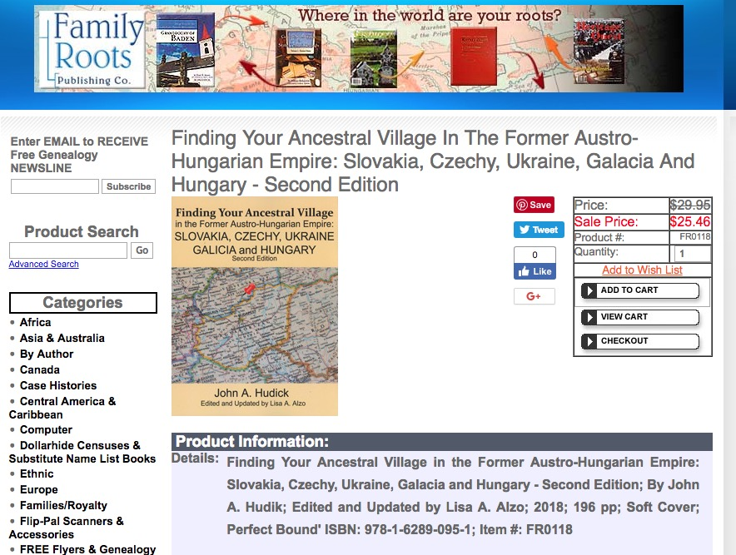
I just ordered this one… as well as a book on DNA research

